Slide 1
Workflows and AI
Mats Rynge, USC Information Sciences Institute / NSF ACCESS
April 3 / Track 1
AI Workshop Denver, CO April 2-3, 2025

Slide 2

This Session
Main takeaways:
Use a workflow system for your AI workloads
Scheduler overlay to simplify resource management
Why ACCESS Pegasus?
Pegasus can be deployed and used in a variety of different ways, such as cli/Jupyter, local install on your machine, a cluster or cloud. One option is a hosted system like the ACCESS Pegasus one we are using today.
Complete any tutorial section we don’t have time to cover today. The tutorial can be used as a self-guided resource.

Slide 3
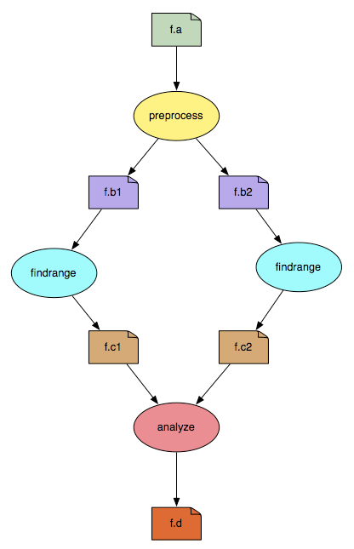
Scientific Workflows
An abstraction to express ensemble of complex computational operations
Eg: retrieving data from remote storage services, executing applications, and transferring data products to designated storage sites
A workflow is represented as a directed acyclic graph (DAG)
Nodes: tasks or jobs to be executed
Edges: depend between the tasks
Have a monolithic application/experiment?
Find the inherent DAG structure in your application to convert into a workflow

Slide 4

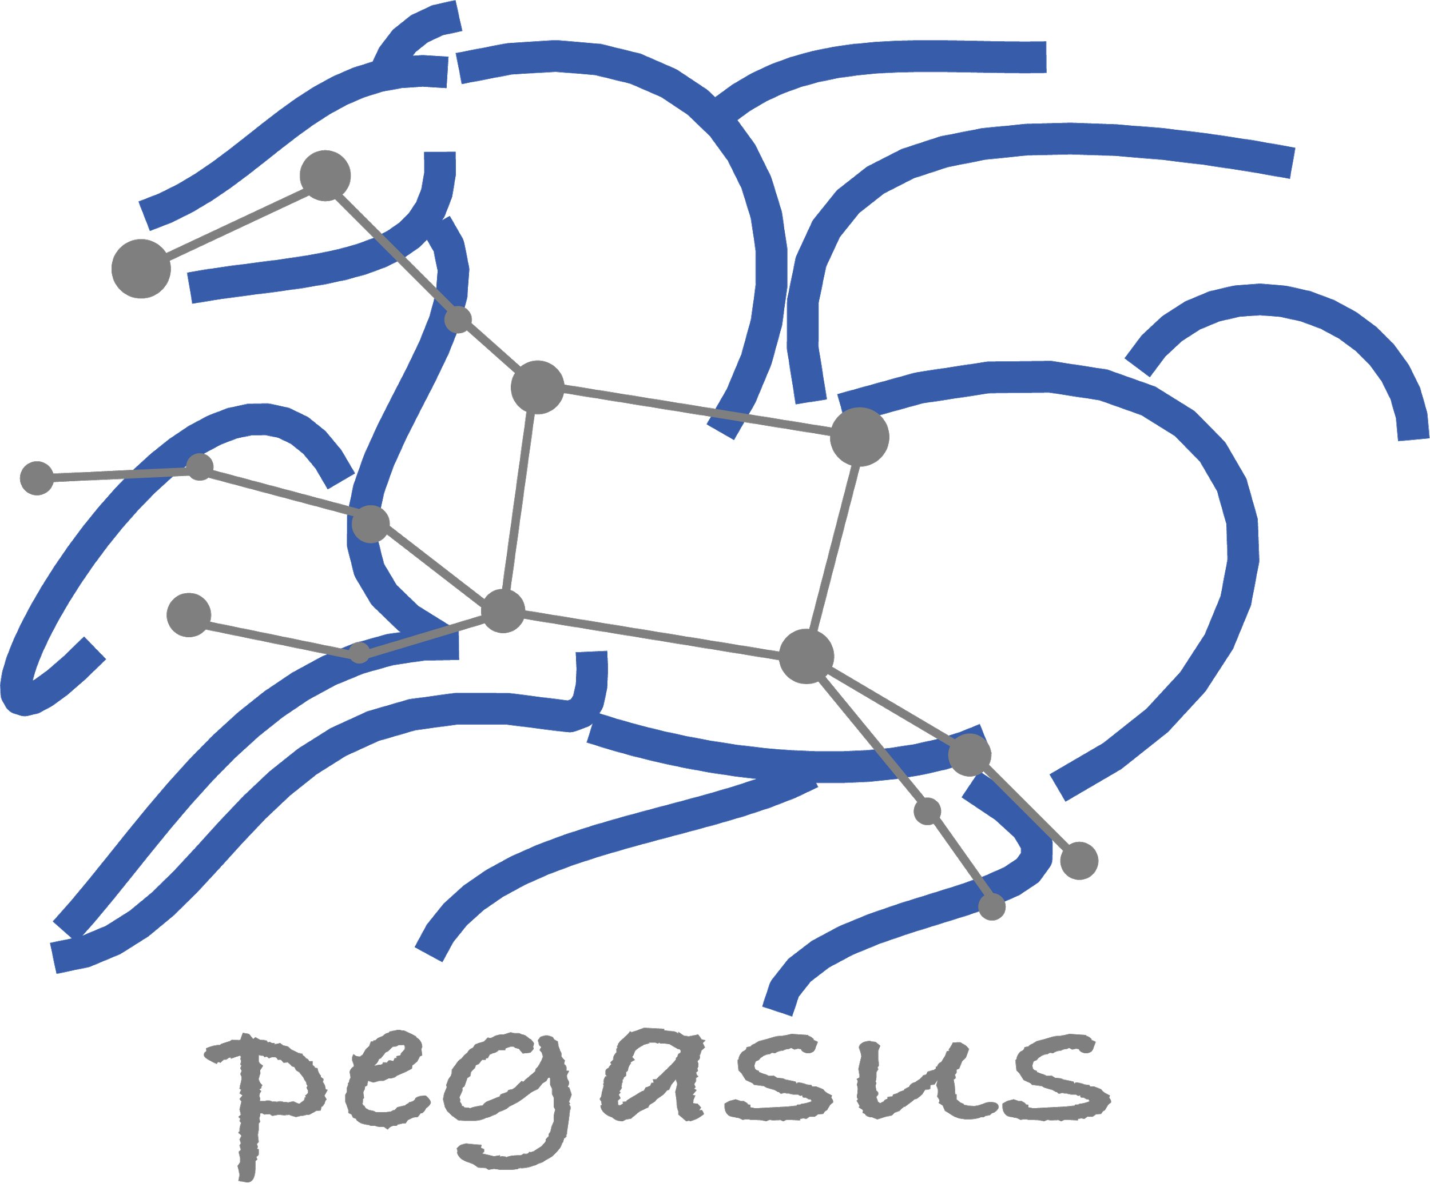
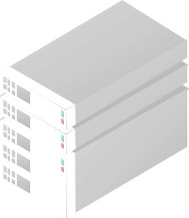

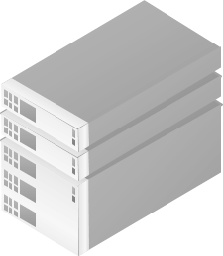
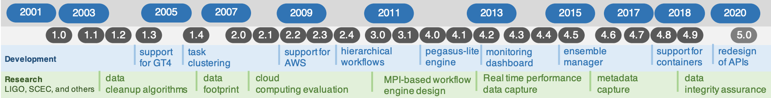

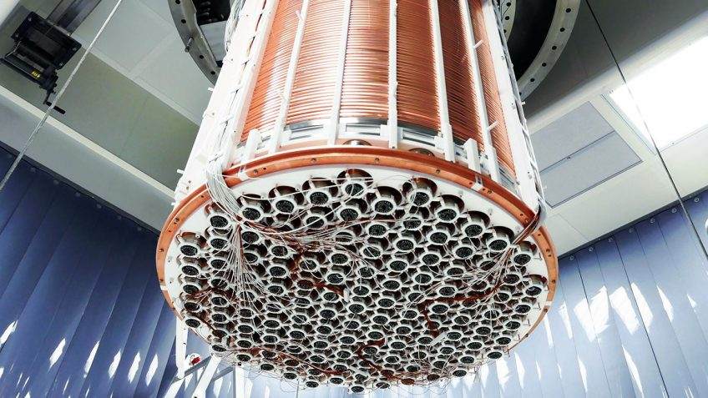
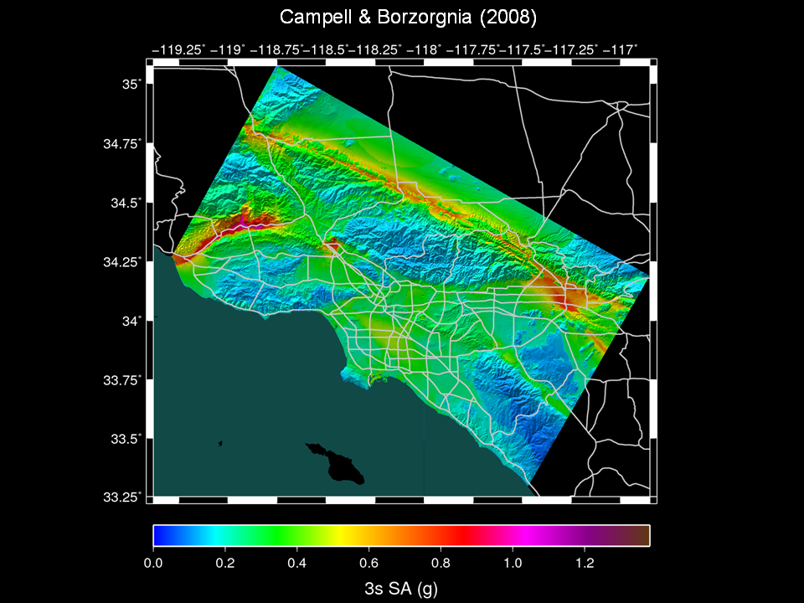
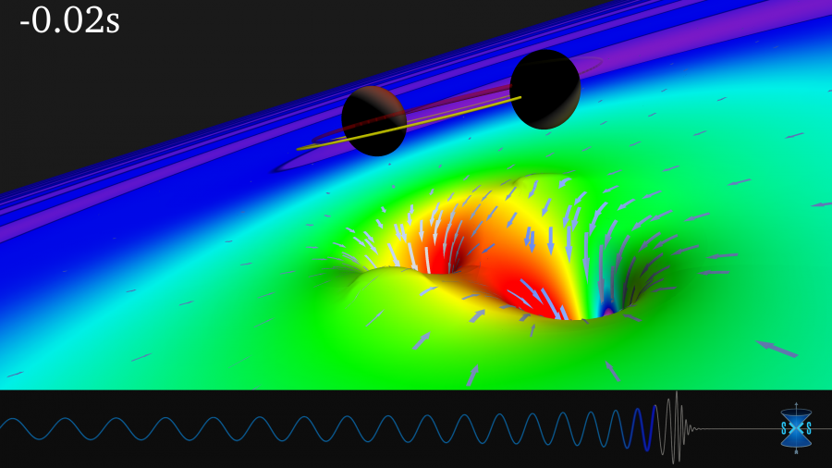
Pegasus Workflow Management System
Pegasus
WMS
End to End Workflow
Management
& Execution
Develop portable scientific workflows in Python, Java, and R
Compile workflows to be run on heterogeneous resources
Monitor and debug workflow execution via CLI and web-based tools
Recover from failures with built-in fault tolerance mechanisms
Regular release schedule incorporating latest research and development
Planner
Monitoring & Provenance
Engine
Scheduler
Job
Queue
jN
> Cloud Resources
> Open Science Grid
> HPC Systems
> HTCondor Pools
j2
j1
The XENONnT detector
Submit Node
Compute Resources
Laser Interferometer Gravitational Wave Observatory (LIGO) develops large scale analysis pipelines used for gravitational wave detection.
Southern California Earthquake Center (SCEC) CyberShake project generates hazard maps using hierarchical workflows .
The XENONnT project uses Pegasus for processing and monte carlo workflows, searching for dark matter
LIGO observation
of colliding black holes
Pegasus
in practice
Hazard map indicating maximum amount of shaking at a particular geographic location generated from SCEC’s CyberShake Pegasus workflow

Slide 5
Pegasus WMS ==
Pegasus planner (mapper) + DAGMan workflow engine + HTCondor scheduler/broker
Pegasus maps workflows to infrastructure
DAGMan manages dependencies and reliability
HTCondor is used as a broker to interface with different schedulers
Workflows are DAGs
Nodes: jobs, edges: dependencies
No while loops, no conditional branches
Jobs are standalone executables
Planning occurs ahead of execution
Planning converts an abstract workflow into a concrete, executable workflow
Planner is like a compiler

Slide 6
Pegasus WMS ==
Pegasus planner (mapper) + DAGMan workflow engine + HTCondor scheduler/broker
Pegasus reasons about data, in order to do automatic placement, movement, and integrity.
Pegasus maps workflows to infrastructure
DAGMan manages dependencies and reliability
HTCondor is used as a broker to interface with different schedulers
Workflows are DAGs
Nodes: jobs, edges: dependencies
No while loops, no conditional branches
Jobs are standalone executables
Planning occurs ahead of execution
Planning converts an abstract workflow into a concrete, executable workflow
Planner is like a compiler

Slide 7
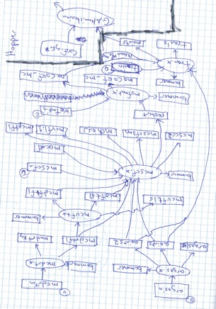
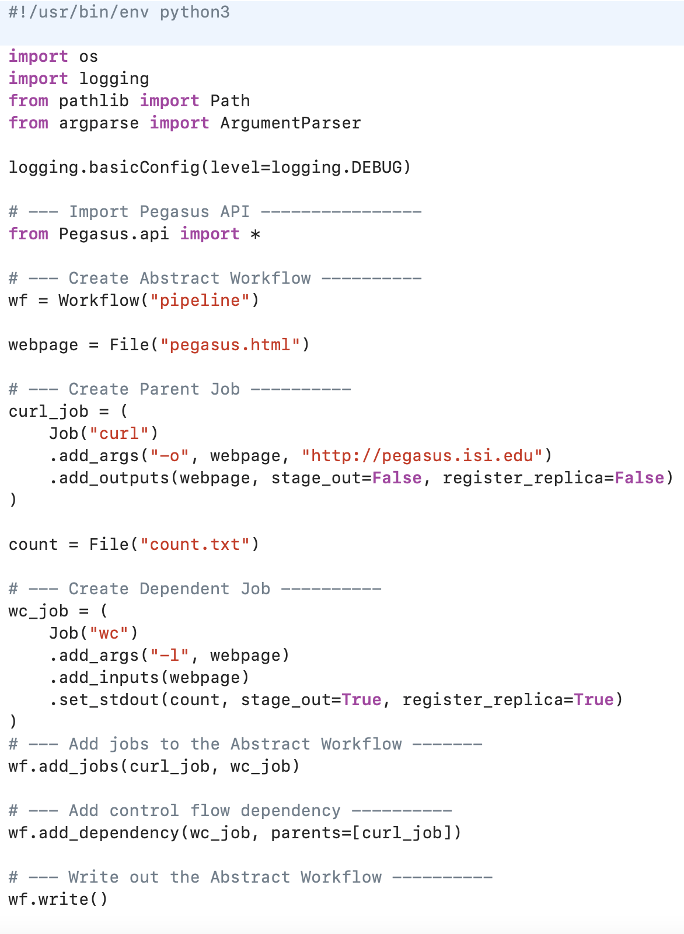
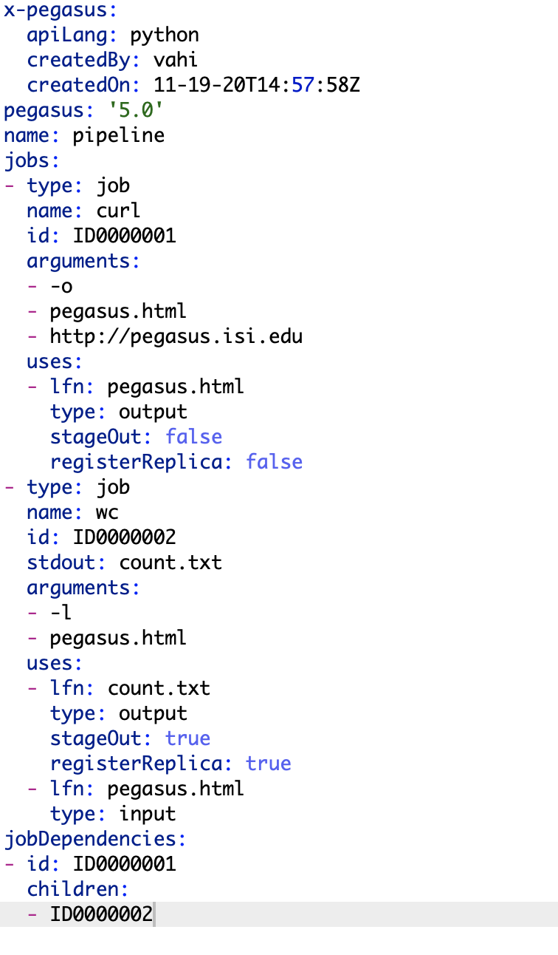



Pegasus provides APIs to generate the Abstract Workflow
Abstract
Workflow
YAML Formatted

Slide 8
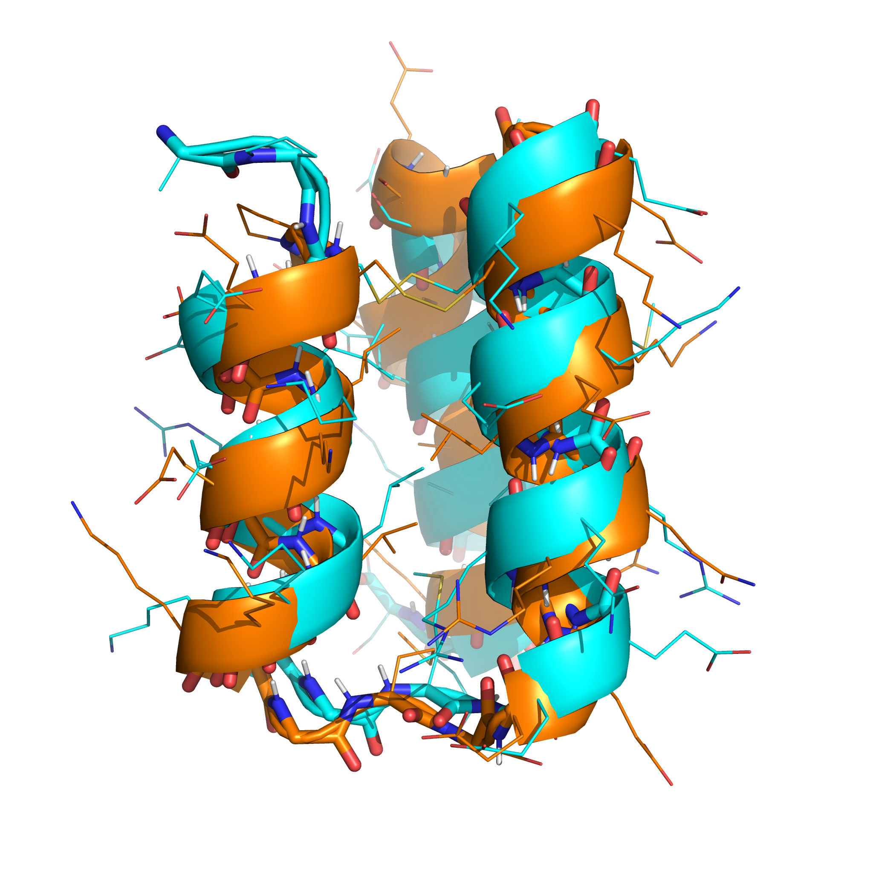

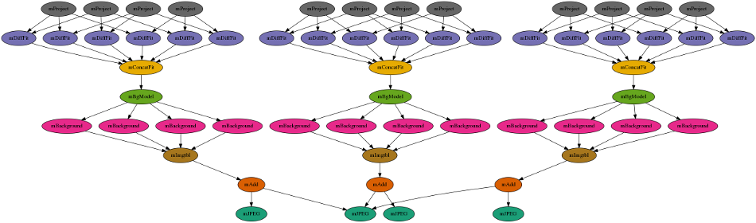
Example Workflows
In addition to tutorial workflows, a set of example workflows are automatically installed into each user account - easy to explore, execute and modify!
Artificial Intelligence
Lung Segmentation
Mask Detection
Orca Sound
LLM + RAG
Astronomy
Montage
Bioinformatics
Alphafold
Rosetta
VariantCalling

Slide 9
LLM - RAG
1. `gpu96`: This flavor provides 4 NVIDIA V100 GPUs (with 32GB of memory each) and 128GB of RAM on the host CPU node.
2. `gpu60`: This flavor offers 2 NVIDIA V100 GPUs (each with 32GB of memory) and 64GB of RAM on the host CPU node.
The Jetstream2 system offers several GPU instance flavors: g3.small, g3.medium, g3.large, and g3.xl. Here's a summary of their specifications:
- g3.small: 4 vCPUs, 15 GB RAM, 60 GB local storage, 20% GPU compute, 20 GB GPU RAM
- g3.medium: 8 vCPUs, 30 GB RAM, 60 GB local storage, 25% GPU compute, 10 GB GPU RAM
- g3.large: 16 vCPUs, 60 GB RAM, 60 GB local storage, 50% GPU compute, 20 GB GPU RAM
- g3.xl: 32 vCPUs, 125 GB RAM, 60 GB local storage, 100% GPU compute, 40 GB GPU RAM
LLM RAG (Large Language Model Retrieval-Augmented Generation) is a technique that enhances large language models by incorporating information retrieval mechanisms.
It involves retrieving relevant information from a database or document corpus and combining it with the original query to provide additional context. This augmented input is then processed by the large language model to generate more accurate and contextually relevant responses.
LLM RAG offers benefits such as improved accuracy, access to up-to-date information, and better contextual understanding, making it useful for applications like question answering, summarization, and conversational AI.

Slide 10



Tutorial: LLM - RAG
Goal: Execute a set of LLMs, locally on NAIRR resources, and use RAG to augment the models and answer a set of predefined prompts.
Container includes full LLM and toolchain (Mistral, LangChain, Chroma)
Workflow Input: Public domain books (Project Gutenberg)
Prompts:
Please provide a one paragraph summary of the book.
Who is the protagonist in the book?
Who is the antagonist in the book?
What time period is the book set in?
Can execute on GPUS from any of the capacity providers: TestPool, Cloud, HTCondor Annex, OSPool

Slide 11
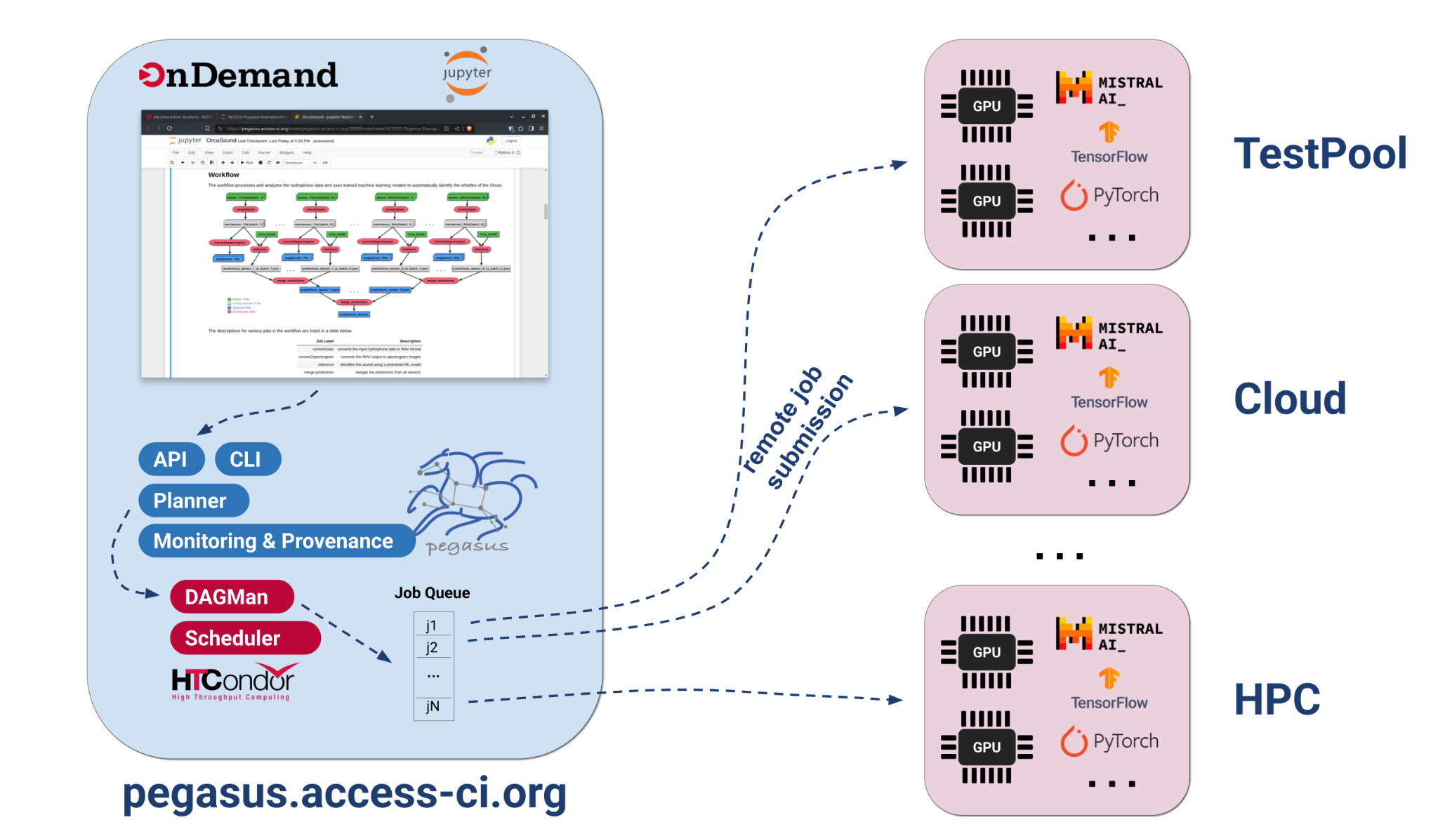

Slide 12
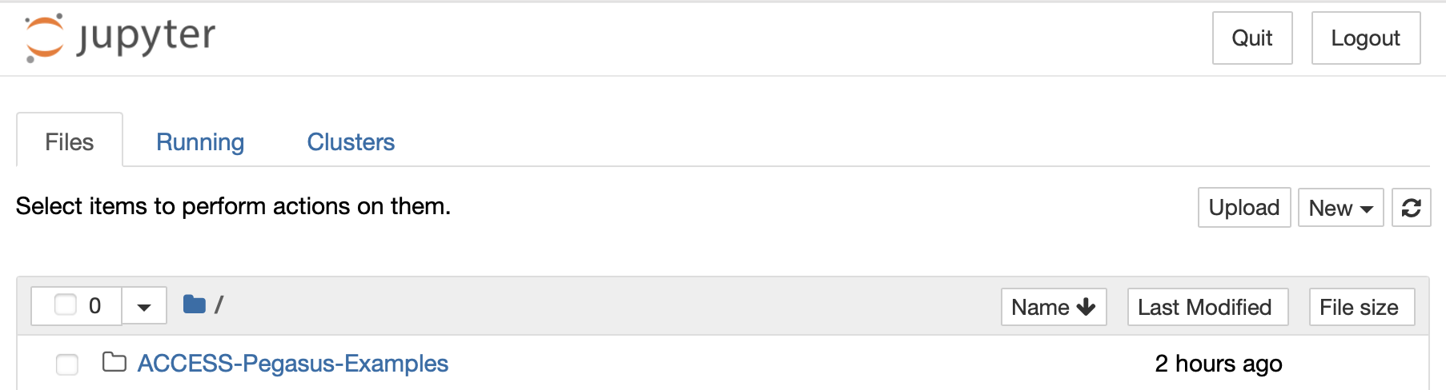
Tutorial Setup
Set of Jupyter Notebooks, contains a mix of overview, pointers, workflows. Step through them one cell at the time, starting from the top.
Log in to ACCESS Pegasus, and start a Jupyter Notebook.
Tutorials can be found in the ACCESS-Pegasus-Examples directory.
Using your ACCESS account, verify that you can use a web browser to log into:
https://pegasus.access-ci.org

Slide 13
Hands on: Running our first workflow
https://pegasus.access-ci.org

Slide 14


Input Workflow Specification
Output Workflow
YAML formatted
Portable Description
Users do not worry about low level execution details
Stage-in Job
Transfers the workflow input data
Logical Filename (LFN)
platform independent (abstraction)
ABSTRACT WORKFLOW
EXECUTABLE WORKFLOW
Cleanup Job
Transformation
Removes unused data
Executables (or programs) platform independent
Stage-out Job
Stage-out generated output data
Registration Job
Registers the workflow output data

Slide 15
So, what other information does Pegasus need?
Site Catalog
Transformation Catalog
Describes the sites where
The workflow jobs are to be executed
Describes all of the executables
(called “transformations”)
used by the workflow
Replica Catalog
Describes all of the input data stored
on external servers

Slide 16
Hands on: Catalogs

Slide 17


And if a job fails?
Postscript
Job Retry
detects non-zero exit code output parsing for success or failure message exceeded timeout do not produced expected output files
helps with transient failures set number of retries per job and run
Checkpoint Files
Rescue DAGs
job generates checkpoint files staging of checkpoint files is automatic on restarts
workflow can be restarted from checkpoint file recover from failures with minimal loss

Slide 18
command-line…
$ pegasus-status pegasus/examples/split/run0001 STAT IN_STATE JOB
Run 00:39 split-0 (/home/pegasus/examples/split/run0001)
Idle 00:03 ┗━split_ID0000001
Summary: 2 Condor jobs total (I:1 R:1)
UNRDY READY PRE IN_Q POST DONE FAIL %DONE STATE DAGNAME
14 0 0 1 0 2 0 11.8 Running *split-0.dag
$ pegasus-analyzer pegasus/examples/split/run0001
pegasus-analyzer: initializing...
****************************Summary***************************
Total jobs : 7 (100.00%)
# jobs succeeded : 7 (100.00%)
# jobs failed : 0 (0.00%)
# jobs unsubmitted : 0 (0.00%)
$ pegasus-statistics –s all pegasus/examples/split/run0001
------------------------------------------------------------------------------
Type Succeeded Failed Incomplete Total Retries Total+Retries
Tasks 5 0 0 5 0 5
Jobs 17 0 0 17 0 17
Sub-Workflows 0 0 0 0 0 0
------------------------------------------------------------------------------
Workflow wall time : 2 mins, 6 secs
Workflow cumulative job wall time : 38 secs
Cumulative job wall time as seen from submit side : 42 secs
Workflow cumulative job badput wall time :
Cumulative job badput wall time as seen from submit side :
Provenance Data
can be Summarized
pegasus-statistics or
Used for Debugging
pegasus-analyzer

Slide 19
Hands on: Statistics

Slide 20
Hands on: Statistics and Debugging

Slide 21
Resources Overlay

Slide 22

Advantages of Glidein (Pilot) Jobs in HTCondor
A glidein (pilot) job in HTCondor is a placeholder job that starts on a remote resource, sets up the HTCondor environment, and transforms the resource into a temporary worker node ready to run user jobs from the central HTCondor pool.
Dynamic Resource Provisioning: Jobs start only when needed, reducing idle time.
Late Binding: Matches jobs to the best resources after provisioning.
Central Management: Unified view of all jobs from a single scheduler.
Efficient Setup: Reuses pilots to run multiple jobs, reducing overhead.

Slide 23
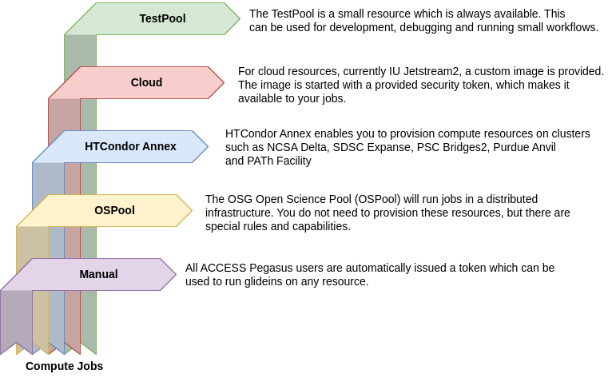
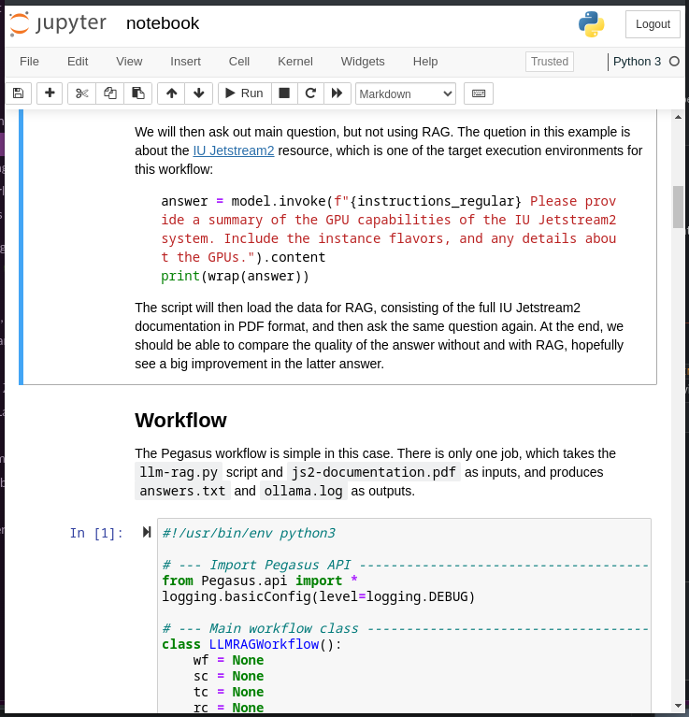

Slide 24
TestPool
Helps users with an ACCESS account but no allocation explore the capability
Small amount of compute resources attached to pegasus.access-ci.org
CPU: 32 cores, 128 GB RAM, 256 GB disk
GPU: 32 cores, 2 GPUs, 128 GB RAM, 256 GB disk
Hosted on IU Jetstream2, provisioned when needed
Always available, no allocation needed
Can be used for quick turnaround jobs
workflow development and debugging
tutorials (not all users might have an allocation at the time of the tutorial)

Slide 25
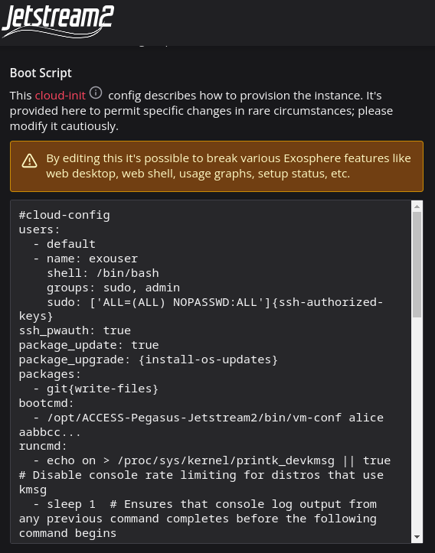
Cloud
IU JetStream2
Provided VM image
Users have to add pegasus.access-ci.org username and token in the cloud-init yaml
Instances self-terminates when there are no more jobs

Slide 26

HTCondor Annex
delta
cpu
cpu-interactive
gpuA100x4
gpuA100x4-preempt
gpuA100x8
gpuA40x4
gpuA40x4-preempt
stampede2
normal
development
skx-normal
expanse
compute
gpu
shared
gpu-shared
anvil
wholenode
wide
shared
gpu
gpu-debug
bridges2
RM
RM-512
RM-shared
EM
GPU
GPU-shared
path-facility
cpu
Bring your own HPC allocation
Semi-managed, submits glideins via SSH.
A glidein can run multiple user jobs - it stays active until no more user jobs are available or until end of life has been reached, whichever comes first.
A glidein is partitionable - job slots will dynamically be created based on the resource requirements in the user jobs. This means you can fit multiple user jobs on a compute node at the same time.
A glidein will only run jobs for the user who started it.
Documentation: https://htcondor.org/experimental/ospool/byoc/
$ htcondor annex create --nodes 1 --lifetime 7200 \
--project sta230005p --gpu-type v100-16 $USER GPU@bridges2

Slide 27
pegasus-glidein
Simple glidein which can be run anywhere, as long as you have outbound network connectivity
Ties in well with ACCESS Pegasus
https://github.com/pegasus-isi/pegasus-glidein
#!/bin/bash
#SBATCH --job-name=glidein
#SBATCH --nodes=10
#SBATCH --ntasks-per-node=1
#SBATCH --cpus-per-task=48
#SBATCH --time=24:00:00
curl -o pegasus-glidein https://raw.githubusercontent.com/pegasus-isi/pegasus-glidein/main/pegasus-glidein
chmod a+x pegasus-glidein
srun ./pegasus-glidein -c pegasus.access-ci.org \
-t mytoken \
-s 'RemoteOwner == "myusername"'

Slide 28
Use a workflow system for your AI workloads
Scheduler overlay to simplify resource management
Complete any tutorial section we don’t have time to cover today. The tutorial can be used as a self-guided resource.

Slide 29
Thank You!
https://pegasus.isi.edu
Pegasus Users Slack and mailing lists: https://pegasus.isi.edu/contact/
E-mail Support: pegasus-support@isi.edu
Office Hours: https://pegasus.isi.edu/office-hours/

